Slide 1
GROUP MEMBERS
Anom Devgun (04)
Seimon Patni (05)
Kartikeya Vishnoi (10)
Pragati Patil (20)
Parikshit Ranjeet Raje (21)

Slide 2
AUTOMATION

Slide 3
why do we need AUTOMATION?
Higher production rates, better product quality and improved safety.
Automated systems typically perform the manufacturing process with less variability than human workers, resulting in greater control and consistency of product quality.
Also, increased process control makes more efficient use of materials, resulting in less scrap.

Slide 4
Things That Go into Automation
Electronics(like microcontrollers, LEDs, various electrical components)
Code(i.e. software to relay human messages to the hardware)
This Brings us to our topic of our use of an Arduino (Specifically the Arduino UNO)

Slide 5
ARDUINO UNO
It is a Microcontroller based on ATMega328 layout (a single chip microcontroller)
It has digital as well as analog pins for I/O that allow it to be used in a wide variety of applications(14 digital I/O and 6 analog input)
It has 32kb of flash memory on board.

Slide 6
ADVANTAGES OF ARDUINO
The biggest advantage is its ready to use structure.;
Library of examples present inside the Arduino IDE;
Syntax based on C and C++;
Compatible with major OSs;
Accessibility, availability and affordability.

Slide 7
Arduino or Raspberry Pi ?
Arduino can be powered using a battery pack, while Raspberry Pi cannot;
Connection with sensors is simple and easy;
Arduino can provide onboard storage;
Former is a plug and play device;
Former is affordable in comparison.

Slide 8
LAYOUT OF THE ARDUINO UNO

Slide 9
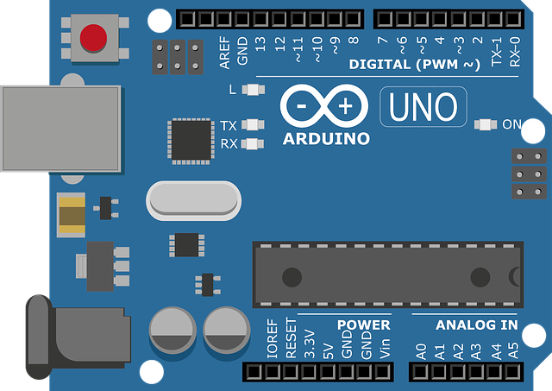
ATMEL CHIP

Slide 10
THE ARDUINO IDE
An IDE (Integrated Development Environment) creates an interface between you and the Arduino board.
The Arduino IDE is a cross-platform application that is written in the programming language Java. It is used to write and upload programs to Arduino board.
The Arduino IDE supports the languages C and C++ using special rules of code structuring.
It follows the logical process of C and C++ programs but the code is written differently.

Slide 11
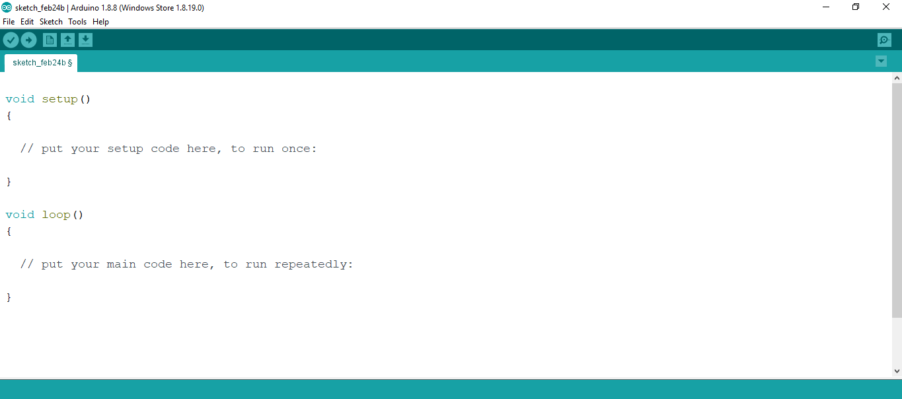
THE ARDUINO IDE

Slide 12
WRITING SKETCHES
Programs written using Arduino IDE are called sketches.
These sketches are written in the text editor and are saved with the file extension .ino.
The message area gives feedback while saving and exporting and also displays errors. The console displays text output by the Arduino Software (IDE), including complete error messages and other information.
The toolbar buttons allow you to verify and upload programs, create, open, and save sketches, and open the serial monitor.

Slide 13
THE PROGRAMS

Slide 14
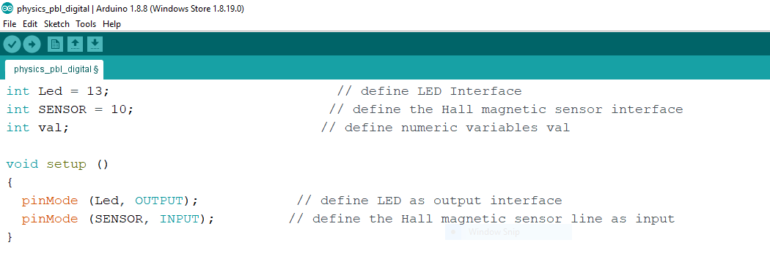
CASE 1 : DIGITAL INPUT FROM SENSOR

Slide 15
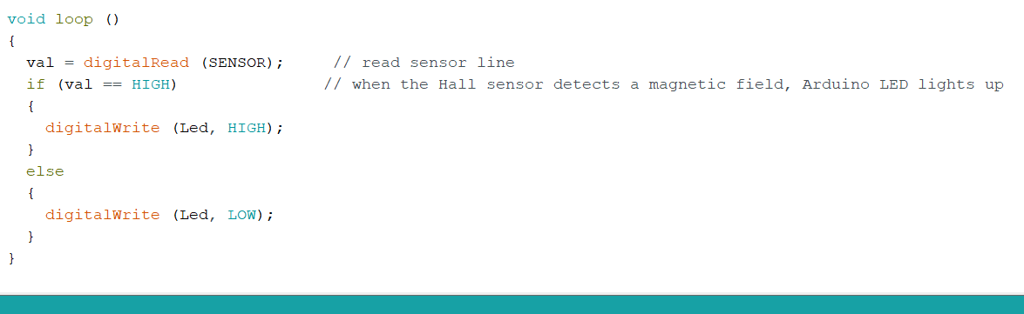
CONTD…

Slide 16
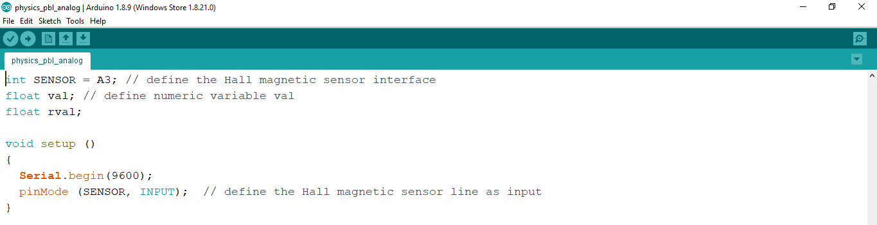
CASE 2 : ANALOG INPUT FROM SENSOR

Slide 17
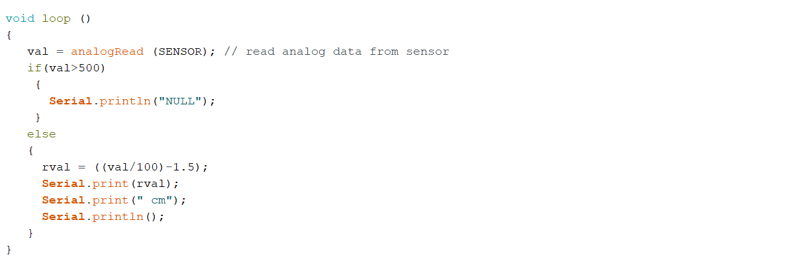
CONTD…

Slide 18
THANK YOU

